Slide 1
RDBMS
Relational Database Management System

Slide 2

WHAT IS A RELATIONAL DATABASE MANAGEMENT SYSTEM (RDBMS)?
A relational database management system (RDBMS) is a program that allows you to create, update, and administer a relational database. Most relational database management systems use the SQL language to access the database.

Slide 3
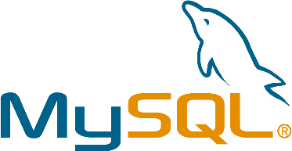


POPULAR RELATIONAL DATABASE MANAGEMENT SYSTEMS
RDBMS, Developed by Oracle, Only available in English, Supports Windows, Linux and Mac,
Open Source, Programmed in C and C++, Has difficulty operating with Kubemetes, Apache Spark and Hadoop Distributed File System
RDBMS, Developed by Oracle, Only available in English, Supports Windows, Linux and Mac,
Open Source, Programmed in C and C++, Has difficulty operating with Kubemetes, Apache Spark and Hadoop Distributed File System
RDBMS, Developed by Microsoft, Only available in multiple languages, Supports Windows, Linux and containers, commercial, Programmed in C++,
Compatible with Kubermetes, Apache Spark and Hadoop Distributed File System

Slide 4
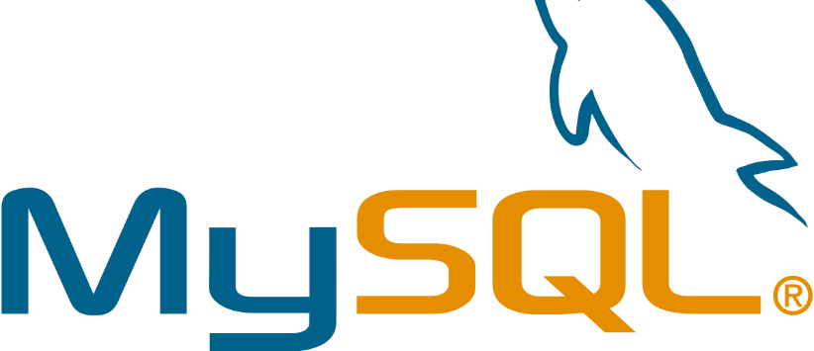
MySQL is the most popular open source SQL database. It is typically used for web application development, and often accessed using PHP.
The main advantages of MySQL are that it is easy to use, inexpensive, reliable (has been around since 1995), and has a large community of developers who can help answer questions.
Some of the disadvantages are that it has been known to suffer from poor performance when scaling, open source development has lagged since Oracle has taken control of MySQL, and it does not include some advanced features that developers may be used to.

Slide 5
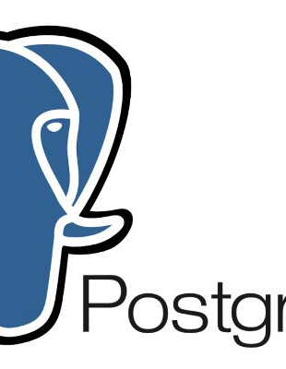
PostgreSQL is an open source SQL database that is not controlled by any corporation. It is typically used for web application development.
PostgreSQL shares many of the same advantages of MySQL. It is easy to use, inexpensive, reliable and has a large community of developers. It also provides some additional features such as foreign key support without requiring complex configuration.
The main disadvantage of PostgreSQL is that it can be slower in performance than other databases such as MySQL. It is also slightly less popular than MySQL.

Slide 6
Microsoft owns SQL Server. Like Oracle DB, the code is close sourced.
Large enterprise applications mostly use SQL Server.
Microsoft offers a free entry-level version called Express but can become very expensive as you scale your application.

